Slide 1

Shuttle
eclipse
eclipse
A Modeling Assistant for Eclipse GMF based on Concept Synchronization

Slide 2
Abstract
Motivation
Concept Synchronization
Linking Model Elements and Concepts
Text Boundary Detection
GMF Integration

Slide 3
Coming Next…
Motivation
Concept Synchronization
Linking Model Elements and Concepts
Text Boundary Detection
GMF Integration

Slide 4
Motivation
What does a modeling synchronization need?
  Refactoring reaches its limit
  E.g. Ecore editor demo, synchronization between “apply” (execute) and “application” (execution)
“Concept synchronization” matters
Notes:
- GUI example, scroll, scrolling…?
- Delete, remove, erase…

Slide 5
Coming Next…
Motivation
Concept Synchronization
Linking Model Elements and Concepts
Text Boundary Detection
GMF Integration

Slide 6
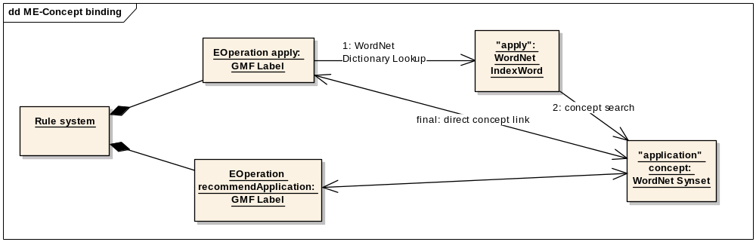
Concept Synchronization
WordNet
  E.g. Web interface demo, navigate from “apply” to “application”
Concept based on WordNet Synset

Slide 7
Coming Next…
Motivation
Concept Synchronization
Linking Model Elements and Concepts
Text Boundary Detection
GMF Integration

Slide 8
Linking Model Elements and Concepts –
Java WordNet Library (JWNL)
From String to Synset
  IndexWordSet Dictionary.lookupAllIndexWords (java.lang.String lemma)
  IndexWord[] IndexWordSet.getIndexWordArray()
  Synset[] IndexWord.getSenses()
    Basic concept search

Slide 9
Linking Model Elements and Concepts (cont.)
Extended concept search
PointerTargetNodeList Synset.getDerived
(Synset synset)
PointerTargetNodeList Synset.getSynonyms
(Synset synset)
PointerTargetNodeList Synset.getDirectHypernyms (Synset synset)
PointerTargetNodeList Synset.getDirectHyponyms
(Synset synset)
...
Each Node contains:
  a PointerTarget (a Synset or Word)
  the type of relationship that the Node has to the other elements in the list and/or to the source word.

Slide 10
Coming Next…
Motivation
Concept Synchronization
Linking Model Elements and Concepts
Text Boundary Detection
GMF Integration

Slide 11
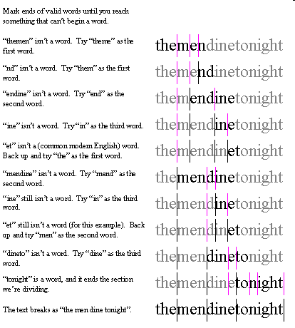
Text Boundary Detection – java.text.BreakIterator

Slide 12
Text Boundary Detection (cont.)
Sentence boundary analysis
  BreakIterator BreakIterator.getSentenceInstance()
  void BreakIterator.setText(String newText)
  int BreakIterator.next()
  String String.substring
  (int beginIndex, int endIndex)
Word boundary analysis
  BreakIterator BreakIterator.getWordInstance()
  ...

Slide 13
Coming Next…
Motivation
Concept Synchronization
Linking Model Elements and Concepts
Text Boundary Detection
GMF Integration

Slide 14
GMF Integration
Monitoring Label element first
  By registering listeners
Visual synchronization recommendation
  Recommendation hint as Label decoration
    Is Presentation Decorator Providers extension point enough?
  Recommendation as View/IFigure
    Can CreationTool help?
  In case of multiple recommendations
    Displayed like Content Assist or something else
Notes:
(Concrete goals)

Slide 15
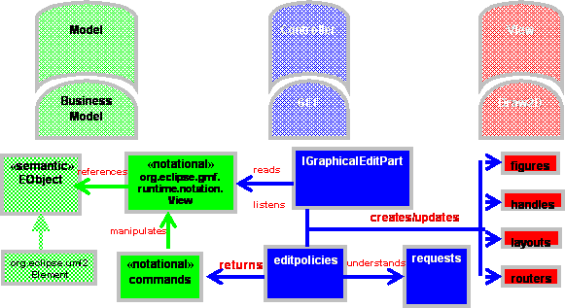
GMF Integration (cont.)
GMF Model-View-Controller Pattern
(from GMF SDK Help)

Slide 16
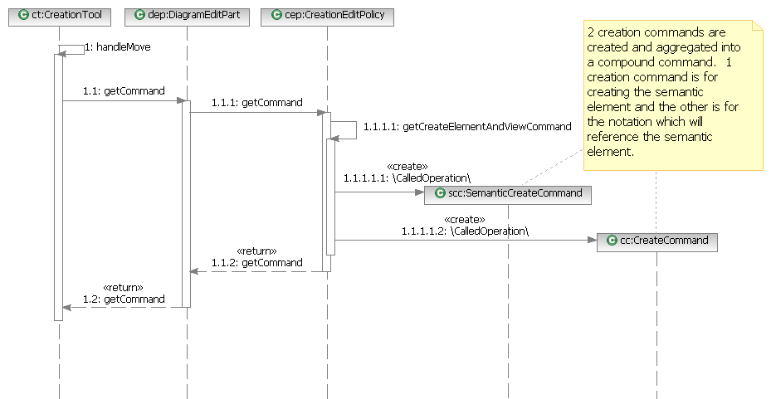
GMF Integration (cont.)
Canonical Model Element Creation in GMF (Phase I)
(from GMF SDK Help)

Slide 17
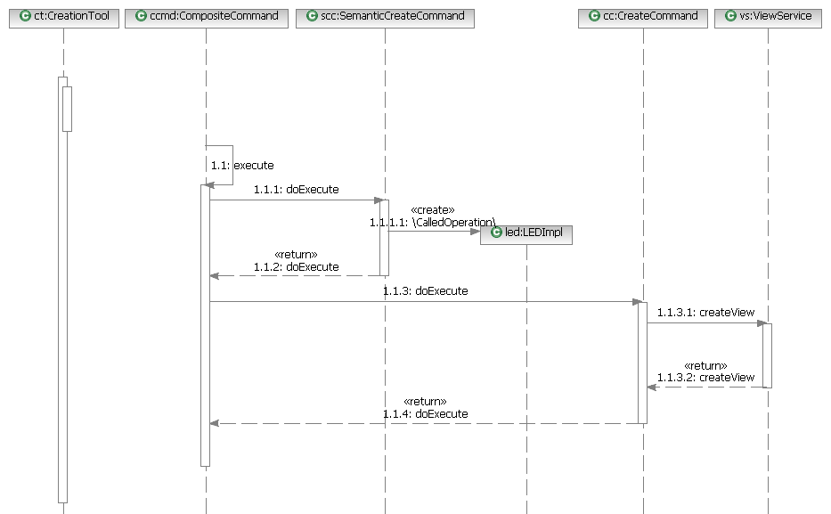
(Phase II)

Slide 18
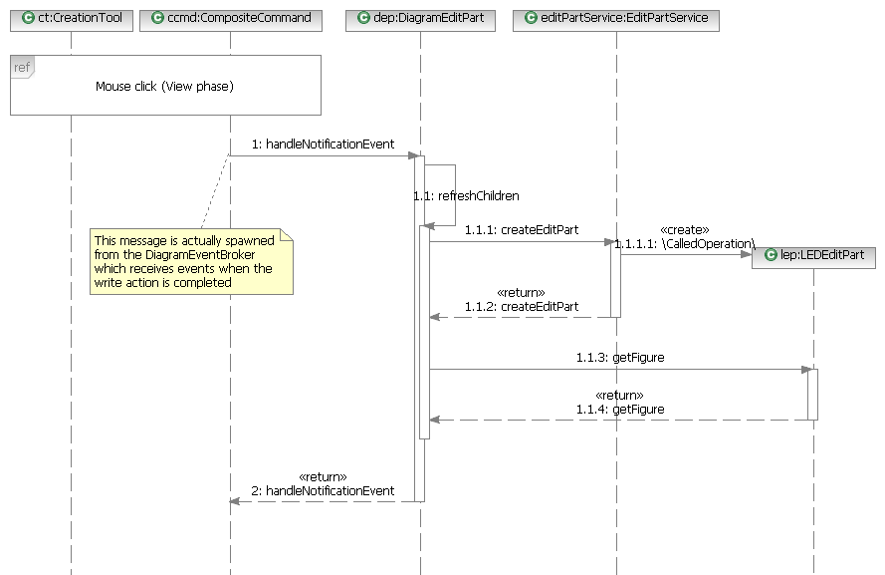
(Phase III)

Slide 19
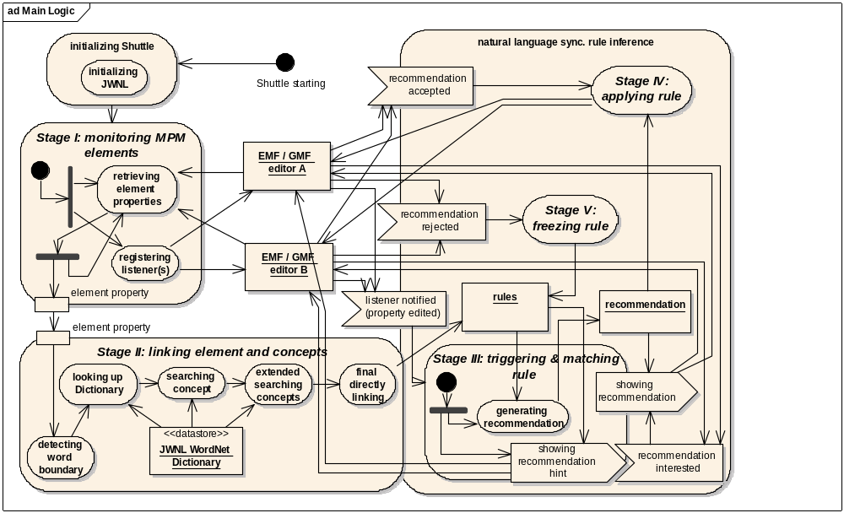
Shuttle in a nutshell

